Slide 1
Sports and the Media*
Prof. Charles Fine
MIT Sloan School of Management
& MIT Engineering Systems Division
Co-Director, MIT Communications Futures Program
October 2013
(*with help from Emmanuel Blain, Halil Kiper,
Sergey Naumov, and Tessa Skot)

Slide 4
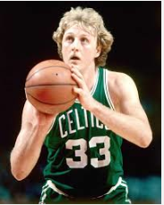

Slide 5
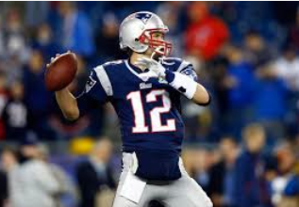

Slide 6
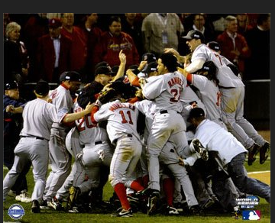

Slide 7
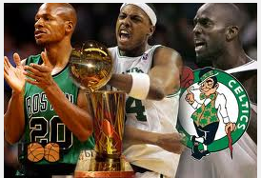

Slide 9
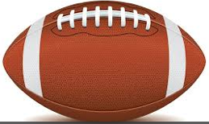
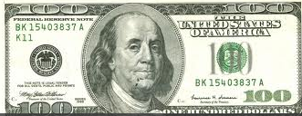
Sports / Media Value Chain (Simplified)
content
revenue
Content
owners,
e.g., NFL
Producers
& Channels,
e.g., ESPN
Connectivity
Conduits
e.g., Comcast
Consumers
Advertisers
e.g., Nike

Slide 10
Value Chain Dynamics are influenced by
multiple, interlocking drivers
Corporate
Strategy
Dynamics
Regulatory
Policy
Dynamics
Technology
& Innovation
Dynamics
Industry
Structure
Dynamics
Customer
Preference
Dynamics
Business
Cycle
Dynamics
Capital
Market
Dynamics
Gears differ by size/speed
Each has an engine & clutch

Slide 11
THE DYNAMICS OF PRODUCT ARCHITECTURES,
STANDARDS,AND VALUE CHAIN STRUCTURE:
“THE DOUBLE HELIX”
INTEGRAL PRODUCT
VERTICAL INDUSTRY
PROPRIETARY STANDARDS
MODULAR PRODUCT
HORIZONTAL INDUSTRY
OPEN STANDARDS
NICHE
COMPETITORS
INNOVATION & TECHNICAL ADVANCES
HIGH-
DIMENSIONAL
COMPLEXITY
SUPPLIER
MARKET POWER
PRESSURE TO
DIS-INTEGRATE
INCENTIVE TO
INTEGRATE
ORGANIZATIONAL
RIGIDITIES
PROPRIETARY SYSTEM
PROFITABILITY
Examples: IBM, GM, Citibank, Google, Apple, Disney, Comcast
Fine & Whitney, “Is the Make/Buy Decision Process a Core Competence?”

Slide 12
Technology and Industry Disruptions (C. Vaishnav)
Industry
Disruption
No Industry
Disruption
Weak Incumbent
Network Effect
• Strong Entrant
Network Effect
Incumbents can affect
switching behavior
Digital
music
Incumbents innovate
while maintaining quality
• Incumbents control
complementary assets
Electric
vehicles
Technology
Disruption
Consumer highly price
sensitive and willing to
risk adopting innovative
service with low quality
and compatibility
Entrants struggle to
offer quality due to lack
of functional control
or market power
Quadrant Not Relevant
Strong Incumbent
Network Effect
Linux vs.
Windows
No
Technology
Disruption
Consumers value quality
and compatibility over
innovation and low price

Slide 13
Sports / Media Value Chain (Simplified)
content
revenue
Content
owners,
e.g., NFL
Producers
& Channels,
e.g., ESPN
Connectivity
Conduits
e.g., Comcast
Consumers
Advertisers
e.g., Nike

Slide 14
Estimated Size of the Entire Sports Industry, U.S. |  |  |  |  | $470B
Annual Company Spending for Sports Advertising, U.S. |  |  |  |  | $31.5B
Major League Baseball (MLB) |  |  |  |  | $6.8B
NFL League Revenue |  |  |  |  | $8.8B
NBA |  |  |  |  | $3.7B
NHL |  |  |  |  | $3.4B
NCAA |  |  |  |  | $871M
NASCAR |  |  |  |  | $612M
http://www.plunkettresearch.com/sports-recreation-leisure-market-research/industry-statistics

Slide 15
Today, nearly 100 million households pay about $5.54 a month for ESPN, regardless of whether the subscribers watch it or not, whether they realize it or not. This year, ESPN will take in more than $6 billion in subscriber fees.
“College Football’s Most Dominant Player? It’s ESPN,” The New York Times By JAMES ANDREW MILLER, STEVE EDER and RICHARD SANDOMIR, AUGUST 24, 2013

Slide 16
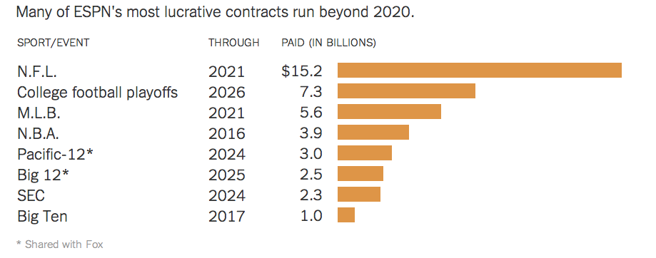
ESPN’s spending on Sports Content
Is this sustainable?
Source: “College Football’s Most Dominant Player? It’s ESPN,” The New York Times
By JAMES ANDREW MILLER, STEVE EDER and RICHARD SANDOMIR, AUGUST 24, 2013

Slide 17
College Sports & Advertising
Advertisers drool over the college sports fan base of 172 million people, who need to buy insurance and cell phone plans and potato chips and cars and clothes and beer and hundreds of other products they haven’t realized they need yet.
http://collegestats.org/articles/2012/08/the-biggest -advertisers-behind-college-sports/ (accessed 21Oct2013)

Slide 18
A Tale of two Football Teams: Duke and Louisville
What ESPN offered Louisville, beyond millions of dollars in fees for television rights, was primetime exposure on the leading sports network . . .
The cost to Louisville? It had to be ready to play whenever ESPN could fit the Cardinals into its schedule.
“Louisville came to us and said, ‘We’ll play anyone, anywhere, anytime,’ ”
When he took over in 1997, the athletic department struggled on an annual budget of about $14 million and attracted little outside attention for sports other than men’s basketball. Today, the budget has swollen to about $77 million, and it will increase significantly with the move to the A.C.C. in 2014.

Slide 19
A Tale of two Football Teams: Duke and Louisville
“And so for our amusement, for America’s amusement, ” he added, “my students and your students are being yanked out of class to make us happy. And then they’re getting on the plane and we’re getting back at 3 in the morning exhausted and drained, and then we’re wondering why our kids aren’t performing better.” (Prof. Alex DeSantis, Kentucky)
In a recent interview, Mr. DeSantis said he had tried to persuade SEC presidents to agree on a rule barring athletes from missing more than 20 percent of classes because of games. He failed.
“College Football’s Most Dominant Player? It’s ESPN,” New York Times By JAMES ANDREW MILLER, , STEVE EDER and RICHARD SANDOMIR, AUGUST 24, 2013
“At Louisville, Athletic Boom Is Rooted in ESPN Partnership,” New York Times By JAMES ANDREW MILLER, , STEVE EDER and RICHARD SANDOMIR, AUGUST 25, 2013

Slide 20
A Tale of two Football Teams: Duke and Louisville
“Football, as the most exaggerated form of intercollegiate athletic competition, should no doubt, be abolished . . . The athletic is is being substituted for the intellectual ideal.” William Preston Few, Dean and English Professor Duke, 1906
Twenty Five years later, as President of Duke, Few hired Wallace Wade away from Alabama, leading to three decades of football dominance featuring the 1938 regular season when the team went undefeated and unscored upon. Wade’s record as football coach (through 1050) was 110-36-7.
1960: Duke beats Arkansas 7-6 before 74,000 fans at the Cotton Bowl. It would be the Blue Devils’ last bowl appearance for 29 years.
Duke Magazine Fall 2013

Slide 21
A Tale of two Football Teams: Duke and Louisville
During a period of budget shortfalls, Duke’s Academic Council recommended that Duke de-emphasize intercollegiate athletics and drop out of the ACC.
“the academic standards and programs of Duke University differ significantly from those of a majority of [ACC] members,” . . .
[Duke] “should leave the Atlantic Coast Conference and seek competition with educational institutions whose standards, programs, and interests are compatible with our own.”
Duke Magazine Fall 2013

Slide 22
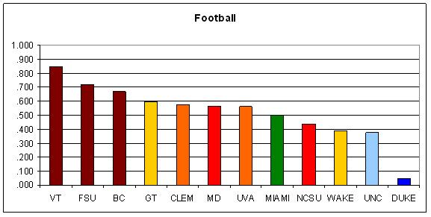
ACC Football
Win Percentages, 2000-2008
Source: http://www.statefansnation.com/index.php/archives/2008/07/18/the-state-of-state-part-five-acc-rankings-bar-graphs-galore/

Slide 23
A Tale of two Football Teams: Duke and Louisville
Says Kennedy: “I remember in ’77, which was the first year of our contract to go to Michigan two years in a row, [head football coach] Mike McGee ’60 said to me, ‘They’re throwing these kids to the lions for $200,000.’ ” Duke lost the two games by a combined score of 73-9.
1996, 2000, 2001, 2006: Duke failed to win a game.
From ’95-’07, the Devils suffered through ACC losing streaks of 21, 30, and 25 games.
Duke Magazine Fall 2013

Slide 24
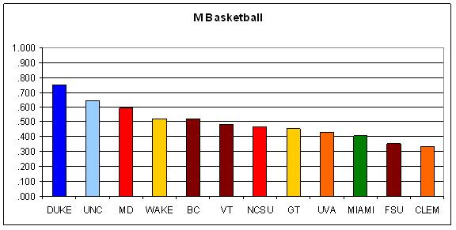
ACC Basketball Win Percentages, 2000-2008
Source: http://www.statefansnation.com/index.php/archives/2008/07/18/the-state-of-state-part-five-acc-rankings-bar-graphs-galore/

Slide 25
In the summer of 2010, the Big 12—one of the five BCS conferences—teetered on the brink of collapse when Nebraska left for the Big Ten and the Pac-10 poached Colorado and nearly picked off Texas and Oklahoma, among others. In that scenario the Big 12 schools best known for basketball success would have been big losers.
Duke Magazine Fall 2013

Slide 26
“How necessary is it for Duke University to have big-time basketball? If you assume it is necessary, then you have to start talking about how important is football for the basketball. I don’t think anybody’s asking the first question [at Duke].”
Duke Magazine Fall 2013

Slide 27
Duke increases football spending
By 2011, Duke was spending over $25 million on football, but only earning around $20 million a year
Men’s basketball, in comparison, makes almost $10 million a year in profit (Duke Magazine, Fall 2013, p. 8)
Duke’s football program’s costs are expected to continue rising
Little to no outrage on campus over rising football costs; rather increase school spirit and interest in the football team
20,000 Duke fans travelled to Charlotte for the Belk Bowl
“Duke sold 11,000 of those tickets directly to fans, the most tickets sold by any ACC school to a bowl game [that] year” ((Duke Magazine, Fall 2013, p. 8)

Slide 28
Value Chain Dynamics are influenced by
multiple, interlocking drivers
Corporate
Strategy
Dynamics
Regulatory
Policy
Dynamics
Technology
& Innovation
Dynamics
Industry
Structure
Dynamics
Customer
Preference
Dynamics
Business
Cycle
Dynamics
Capital
Market
Dynamics
Gears differ by size/speed
Each has an engine & clutch

Slide 29
THE DYNAMICS OF PRODUCT ARCHITECTURES,
STANDARDS,AND VALUE CHAIN STRUCTURE:
“THE DOUBLE HELIX”
INTEGRAL PRODUCT
VERTICAL INDUSTRY
PROPRIETARY STANDARDS
MODULAR PRODUCT
HORIZONTAL INDUSTRY
OPEN STANDARDS
NICHE
COMPETITORS
INNOVATION & TECHNICAL ADVANCES
HIGH-
DIMENSIONAL
COMPLEXITY
SUPPLIER
MARKET POWER
PRESSURE TO
DIS-INTEGRATE
INCENTIVE TO
INTEGRATE
ORGANIZATIONAL
RIGIDITIES
PROPRIETARY SYSTEM
PROFITABILITY
Examples: IBM, GM, Citibank, Google, Apple, Disney, Comcast
Fine & Whitney, “Is the Make/Buy Decision Process a Core Competence?”

Slide 30
Sport$ Dynamic$
Sports and the Media (especially TV) have a very lucrative,
successful relationship. ESPN plays this game very well.
(e.g., College Football)
Traditional sports media revenue streams have some protection (from Internet disruptions) that music, news, and books did not have. (Time shifting value: negative vs. positive)
Nevertheless, even if the masses do not flock to pirated/free sports content in the web, the Internet may still undermine the traditional sports value chain by disrupting all other content that sports programming is bundled with.
What might the next stage/end game look like?

Slide 31
Backup
Slides

Slide 32
Hypotheses/Assertions
0. Value Chains are Dynamic; Media clockspeeds are high.
Sports and the Media (especially TV) have a very lucrative,
successful relationship. ESPN plays this game very well.
Traditional media revenue streams have some protection (from Internet disruptions) that music, news, and books did not have. (Time shifting value: negative vs. positive)
Even if the masses do not flock to pirated/free sports content in the web, the Internet may still undermine the traditional sports value chain by disrupting all other content that sports programming is bundled with.

Slide 33
Value of NFL
broadcasters
Value of NFL

Slide 34
Over the past dozen years, to feed its unending appetite for live football, ESPN has made Louisville Cardinals midweek games a mainstay in prime time. In turn, Louisville has made exposure on
ESPN the centerpiece of a campaign to rise above its commuter-school roots and become a powerhouse in college sports.
“If it wasn’t for ESPN, we would be a fraction of what we are today,” Tom Jurich, Louisville’s longtime athletic director, said in an interview in his office on April 1 as the university savored its latest basketball success: the men’s and women’s teams were each on the way to the Final Four. The men went on to win the N.C.A.A. title.
“At Louisville, Athletic Boom Is Rooted in ESPN Partnership,” New York Times By JAMES ANDREW MILLER, , STEVE EDER and RICHARD SANDOMIR, AUGUST 25, 2013

Slide 35
“We became America’s team at midweek, ” Mr. Jurich said., That familiarity also created a far wider, and deeper, pool of recruits. “All of a sudden we were able to recruit the Deion Branches and Elvis Dumervils and those types of guys, ” Mr. Smith said, referring to two players he coached at Louisville who went on to the N.F.L., In 1999, Stefan LeFors, a high school quarterback in Louisiana, saw the Cardinals play a wild overtime game against Army on ESPN and decided to send a tape of himself to the Louisville coaches.
A week later, the Cardinals traveled to Rutgers for another Thursday night game. They lost in the closing moments, but by season’s end, the reversal was complete: in less than a decade, Louisville had gone from near-winless obscurity to a 12-1 season, including a conference championship and an Orange Bowl victory., Without question, ESPN’s investment had paid off. The back-to-back November games still rank among the top 20 in total viewers for a college football game on ESPN. No longer did the network have to entreat schools to play on weeknights.
“At Louisville, Athletic Boom Is Rooted in ESPN Partnership,” New York Times By JAMES ANDREW MILLER, , STEVE EDER and RICHARD SANDOMIR, AUGUST 25, 2013

Slide 36
Sidereel.com
Free-tv-video-online.me

Slide 37
ESPN
In 2013, over 100 million households pay for ESPN as part of their cable bundles, which earns the network $6 billion in subscriber fees.
This makes is exceptionally valuable to its parent company, Disney
“To this day, the Walt Disney Company would not exist without ESPN. The protection of Mickey Mouse is ESPN.” - Michael Eisner, former Disney Chief Executive (NYT, August 24, 2013)
As a result, ESPN has significant control in setting the schedule for college football – contractually, it has the right to set kickoff times and wait until 12 days before game day (or sometimes even 6) to tell the universities
ESPN also created and owns the software that schedules games (Pigskin Access Scheduling System)

Slide 38
ESPN – the kingmaker
ESPN has spent over $10 billion on college football in the last 5 years, making it “both puppet-master and kingmaker” with control over “arranging games, setting schedules and bestowing the gift of nationwide exposure on its chosen universities, players and coaches.” (NYT, August 24, 2013)
“The growth of the exposure to college football is directly related to ESPN’s increased involvement in it.” - Bernie Machen, University of Florida President (NYT, August 24, 2013)
ESPN is far and away the largest network player in college football – it televises 9 times as many games as its next closest competitor

Slide 39
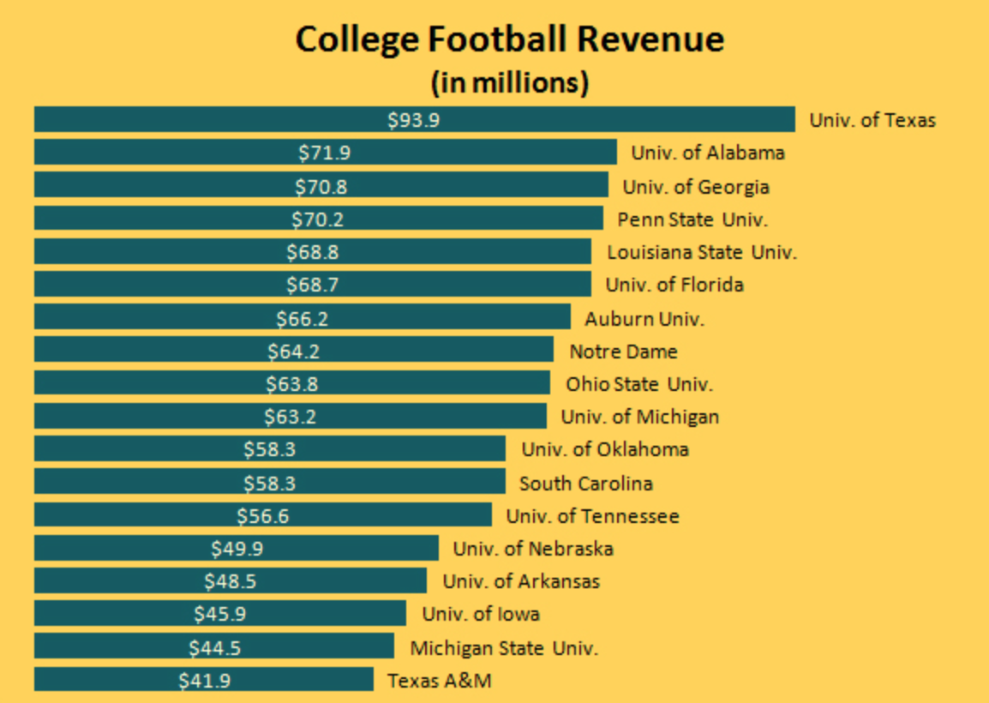
Image source: Business Insider, September 28, 2011. http://www.businessinsider.com/ncaa-college-football-programs-make-the-most-money-2011-9

Slide 40
Louisville
Since 1995 , “U. of L. is on an upward trajectory,” (James R. Ramsey, President of University of Louisville, NYT, August 25, 2013) due in large part to its partnership with ESPN
“If it wasn’t for ESPN, we would be a fraction of what we are today.” – Tom Jurich (NYT, August 25, 2013)
In 1995, John. W Shumaker became President of Louisville with the goal of taking the university to greater heights than it currently attained, and using the sports as the gateway to do so
Essentially, “if the athletic program took hold, Louisville could move to a bigger, better conference with a better television deal, putting the whole university — academics and athletics — on a wider national stage.” (NYT, August 25, 2013)

Slide 41
Football – the lynchpin
Football is the most profitable college sport – largest crowds, biggest sponsorship deals and the most rewarding television deals
For a small handful of schools, football teams can make enough money to entirely subsidize the rest of the athletic department, and in some cases, even contribute to the rest of the university
However, such rewards require sizeable investments from the universities

Slide 42
Louisville – investing in success
The university invests $63 million, 42,000-seat, state-of-the-art stadium which opened in 1997.
Partners with ESPN to make their games a mainstay in prime time.
The catch: Louisville has to be ready to play when it fits ESPN’s schedule, including the previously unheard of Tuesday nights
“Louisville came to us and said, ‘We’ll play anyone, anywhere, anytime,’” - Mark Shapiro, former head of programming and production at ESPN (NYT, August 25, 2013)
While it was challenging at first, the schedule change gained them nation-wide fans and a larger pool of potential recruits
““We became America’s team at midweek” Tom Jurich, Louisville Athletic Director (NYT, August 25, 2013)

Slide 43
Louisville – significant rewards
In 1997, the athletic department’s budget was $14 million; today it is $77 million
In addition to the millions it earns in television rights fees from ESPN, Louisville has also gained “millions of dollars in fees for television rights, was prime- time exposure on the leading sports network, putting Cardinals football in front of national audiences of fans, donors, recruits and prospective students.”
Louisville has been able to move from the Conference USA, to the Big East Conference, and not onto the American Athletic Conference
In 7 years in the Big East Conference, Louisville had 3 conference championships, 122 all-Americans, 10 Olympians and a College World Series (NYT, August 25, 2013)
Now, Louisville stands to make $16 million a year as part of the ACC, due to its $3.6 billion contract with ESPN.

Slide 44
Louisville - investing returns
Louisville’s success has allowed it to invest across its athletics:
$72 million renovation of Papa John’s Cardinal Stadium
Trager Indoor Center
Jim Patterson Stadium for the baseball team
Musselman Golf Center
G. Garvin Brown III Rowing Center
Ralph Wright Natatorium
The $283 million KFC Yum Center for the men's and women's basketball teams
A $16.2 million stadium and training complex for the soccer teams is currently under construction
The athletic department also sends $350,000 back to the university each year in addition to a a one-time $2 million donation

Slide 45
Duke -
Historically, basketball was the main driver of success at Duke, while the football team floundered
However, with college football now being significantly more influential in college sports television, the university realized it had to adapt.
Moreover, conference rivals didn’t want to tolerate free riders in the profitable TV contracts
“This is a pretty critical moment in the history of college athletics. There’s a lot at stake.” -Kevin White, Duke vice president and director of athletics (Duke Magazine, Fall 2013, p. 2)

Slide 46
Duke – action steps
Duke invested in top coaching talent, hiring David Cutcliffe for a reported $1.2 million per year
Duke instituted a strategic plan that called for ‘excellence in all sports,’ making “football the linchpin of everything, make generating revenue from football the priority, accomplish that, and then look at some of the non-football things we thought we were going to do.” – Chris Kennedy, deputy director of athletics (Duke Magazine, Fall 2013, p. 7)
Duke invested in a $125 million facilities upgrade, with a significant portion being spent on Wallace Wade Stadium renovations

Slide 47
Source: Big-Time Athletics at Duke, April 2008. http://www.math.duke.edu/~hain/athletics/

Slide 48
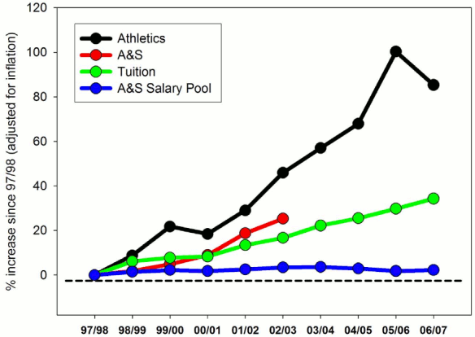
Duke – spending trends
Source: http://www.math.duke.edu/~hain/athletics/

Slide 49
Duke – athletic attitude
Duke “subscribes to the notion that for Duke to continue to thrive in basketball, Duke football must be competitive, or better than that.” (Duke Magazine, Fall 2013, p. 11)
“The bigger question is: How necessary is it for Duke University to have big-time basketball? If you assume it is necessary, then you have to start talking about how important is football for the basketball. I don’t think anybody’s asking the first question.” - Charles Clotfelter, Duke public policy professor and author of Big-Time Sports in American Universities (Duke Magazine, Fall 2013, p.8)

Slide 50
Duke – Football goals
This year’s football goal: “Go to a second consecutive bowl game, something Duke has never done.” (Duke Magazine, Fall 2013, p.12)
“We’ve had so much done for us, and so many people have contributed to what we’re doing here with Duke football, the least we can do is come back with a fire in our belly and a vengeance about winning. That’s what I’m selling our players. The first five years are gone. A lot of people have been involved in helping this thing get off the ground. Now it’s on us.” - Coach Cutcliffe (Duke Magazine, Fall 2013, p.13)

Slide 51
Duke – right choice?
Not everyone believes that football is necessary in order to support other athletic teams, or that basketball can’t be a university’s ‘flagship’ sport
“I was always under the impression that Duke fashioned itself as a leader. By doubling down on football, they’re just following the pack.” - John Gerdy, former Davidson basketball star and SEC deputy commissioner (Duke Magazine, Fall 2013, p. 10)
The ‘Catholic 7’ – seven basketball-only institutions which have left the Big East Conference
Their new TV contract is worth $42 million a year
“If you want to see how important being part of a football conference is to the overall success of [an athletics] department, it’s going to be interesting to see what happens to the Catholic 7.” - Chris Kennedy, Duke deputy director of athletics (Duke Magazine, Fall 2013, p. 11)

Slide 52
Duke – entertainment business
College sports – essentially universities are in the entertainment business, which is distinct to American colleges and universities
Strong athletic programs can help universities in many other ways – recruiting, branding, fundraising, creating strong connections with alumni, etc…
But, universities don’t often portray themselves as being in the entertainment business
“Universities say one thing, and they do another thing. I think they ought to stand up and be straightforward. If entertainment is one thing we do, we ought to do a better job of saying, ‘This is the reason we do it, and it makes sense,’ rather than pretend we don’t do it.” – Charles Clotfelter, Duke public policy professor and the author of Big-Time Sports in American Universities (Duke Magazine, Fall 2013, p.9)

